Slide 1
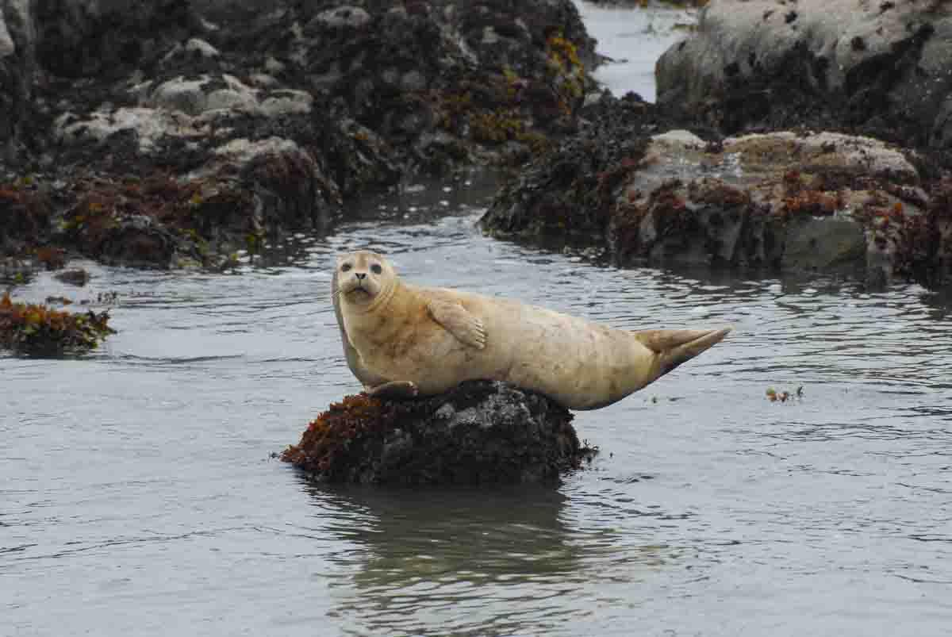
Harbor Seal Project Proposal (Phoca vitulina)
Erin, Megan, Kyle
Bio 263
Notes:
kind of a boring title…?

Slide 2
Intro - “hauling out”
Cost:
Less foraging opportunity
Vulnerability to humans (and in the past, bears)
Limited space/territory
Benefit:
Less metabolic energy wasted to heat loss (heat is lost much more quickly in water than in air)
Less metabolic energy expended physically
Less predation (in open ocean, not in estuary)

Slide 3
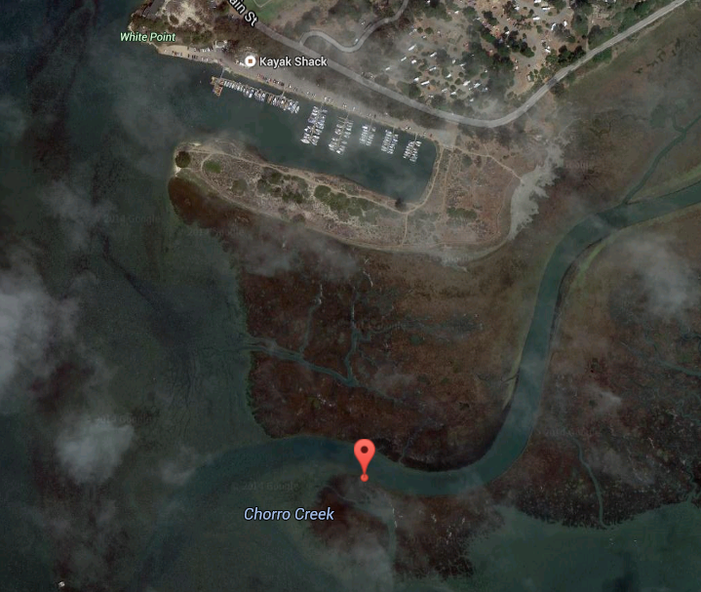
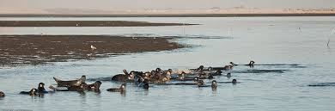
Site #1: Estuary

Slide 4
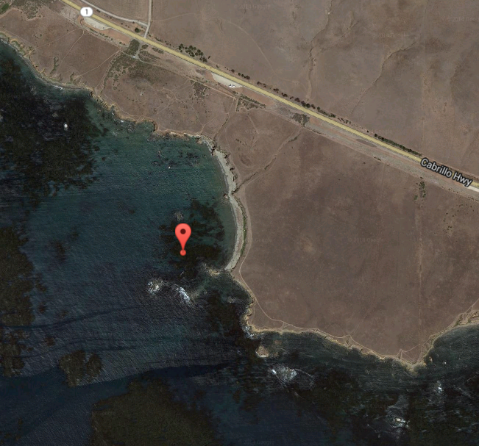
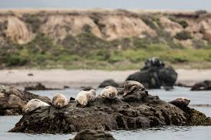
Site #2: Estero Bluffs

Slide 5
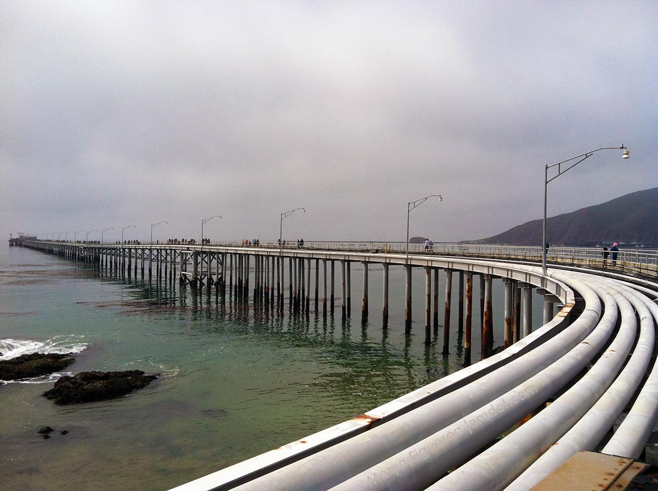
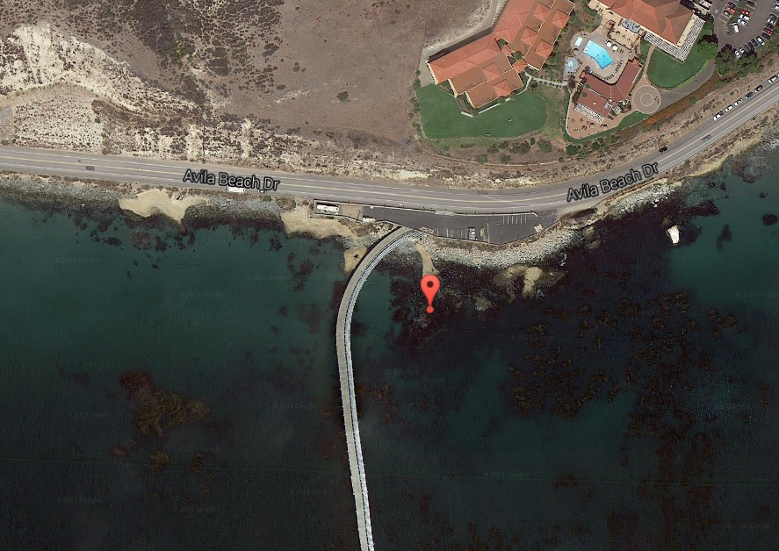
Site #3: Cal Poly Pier

Slide 6
Hypothesis
Harbor seals spend less time hauled out at high tide.
Haul out behavior is independent of time of day.

Slide 7
Variables
DV: number of harbor seals hauled out
IV: time of day, tidal height, air temperature
https://docs.google.com/spreadsheets/d/1-fYOZUjEIa7u4UYoWLO-7vCm3GsPwFNxtnUZL53v3w8/edit?usp=sharing

Slide 8

Methods
Camera at each location
takes photo every hour
records time and air temp
2. Photos used to quantify
harbor seals hauled out
Compare to tide data and
time of day

Slide 9
Statistical Testing
Plot haul out density (HOD) vs time
compare plots to tide level and time of day
take average of HOD at high, low and slack tide and perform t-test
tave average of HOD at dawn, noon and sunset and perform t-test
Notes:
just one way I thought we could do it...let me know! because its kind of hard to quantify photoperiod?? not sure...

